Slide 1
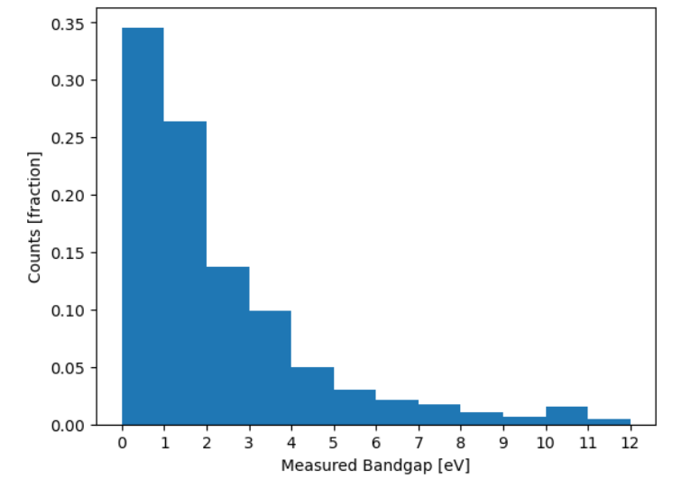
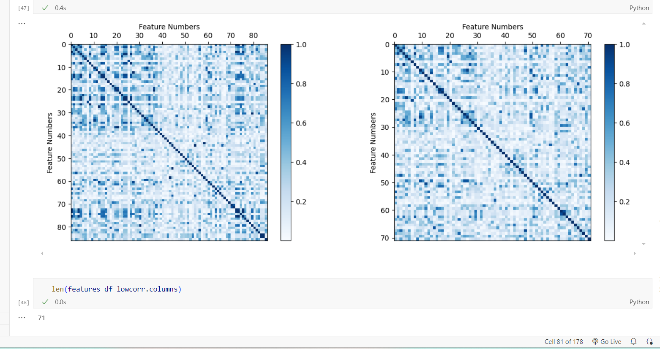
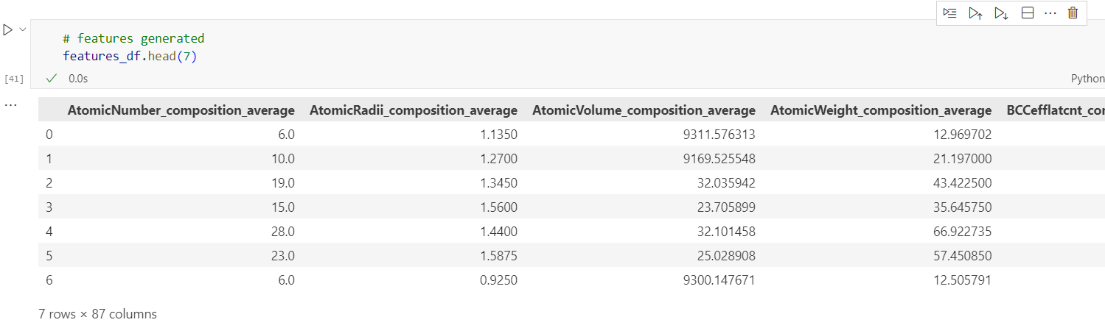
Assessment Figures

Slide 2
ML4ER Assignment 2
Jiahui Yang
Informatics Skunkworks
MSE 401, 3 Credits
Jul 21 2024

Slide 3
Progress
Histogram plot before exercise 1.4
According to the histogram plot, we have more data in 0–4 than 5–12. It appears to be right-skewed or positively skewed, meaning that there are more data points at lower band gap values, and the frequency of data points decreases as band gap values increase. Thus, it is not uniformly distributed across its range and our band gap data is not balanced.

Slide 4
Progress
Screenshot of the “features_df” from section 2
There are 87 features that we generated.

Slide 5
Progress
Correlation matrix after removing highly correlated features above exercise 3.2
There are 71 features left.

Slide 6
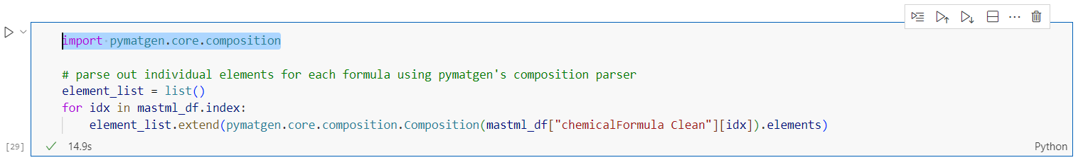
Problems
On my local PC, I need to use “import pymatgen.core.composition” for the following code to work, even though we have already used “import pymatgen” at the beginning.

Slide 7
Questions
I am having difficulty understanding correlated features and determining how to choose the appropriate normalization or rescaling method for our features.
Answered in the Friday discussion

Slide 8
Hours Summary
Date | Hours | Description of Work
07/18/2024 | 2.5 hours | Complete through section 3 of module 1

